Slide 1
POS(Park On Spot):
~ A smart parking system for future
Submitted in the partial fulfillment for the award of the degree of
BACHELOR OF ENGINEERING
IN
B.E – CSE (Internet of Things)
Submitted by:
Joydeep Chandra
Amrit Raj Shankar
Vikram Kumar Jha
Pranav
Ronak
Under the Supervision of:
SUPERVISORS NAME :
Arvind Punar
DISCOVER . LEARN . EMPOWER
Department of AIT-CSE

Slide 2
Outline
Introduction to Project
Problem Formulation
Methodology used
Future Scope
Conclusion
References

Slide 3
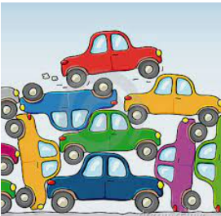
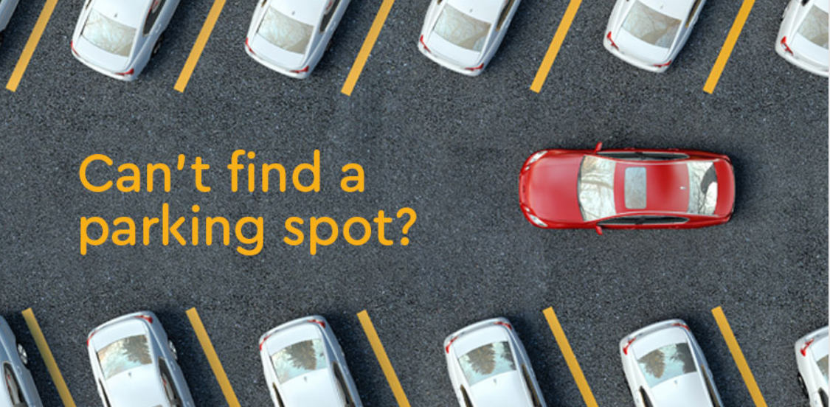
Introduction to Project
In today’s modern and fast moving world where vehicles are increasing very rapidly ,parking has become a tedious task to manage. Mismanagement of parking leading to vehicle getting stuck ,accidents in some cases, etc has become a common issue.

Slide 4
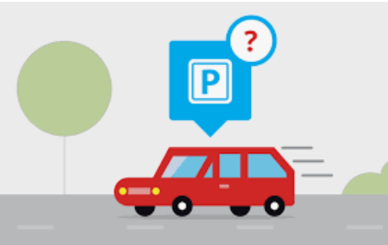
Introduction to Project (cont.)
So we are proposing a smart parking management system for a hustle free parking and efficient use of parking space.
This system will be monitored by an application that will have data of all parked vehicle and their time slots and customer can check availability of parking space through this app.

Slide 5
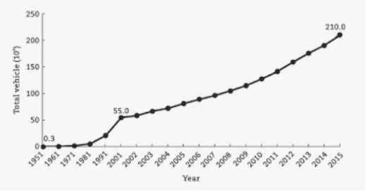
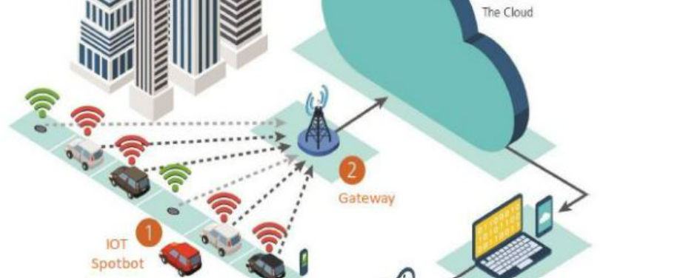
Problem Formulation (contd.)
As number of vehicles are increasing exponentially ,the human managed methodology is not sufficient to counter parking issue.

Slide 6

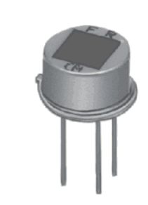
Problem Formulation
So our project aim to build a smart parking system that will manage parking smoothly and efficiently.
We will be using PIR motion sensor to detect each and every vehicle’s entry and exit to the parking spot .A counter will maintained using cloud.
Through IoT(app) users can see whether the parking spot empty or not .we can also assign slot time to each vehicle coming to the parking area.

Slide 7
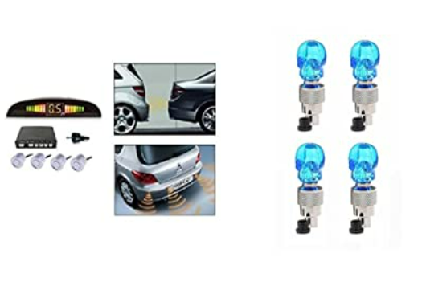
Methodology used
The following methodology will be followed to achieve the objectives defined for proposed research work:
Sensing entry of each vehicle using PIR sensor

Slide 8
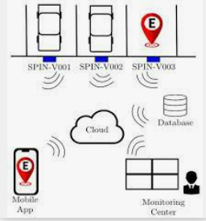
Methodology used
Registration Process :User need to provide detail through app.
Sending data to cloud and app development: To book slot ,using app vacancy of spot can be checked

Slide 9
Future Scope
We can make this system scalable so that a single app can maintain parking spot of whole city.
People from anywhere can book parking spot just by using maps.
Camera module to capture driver’s picture to check real identity
Smart street lightening

Slide 10
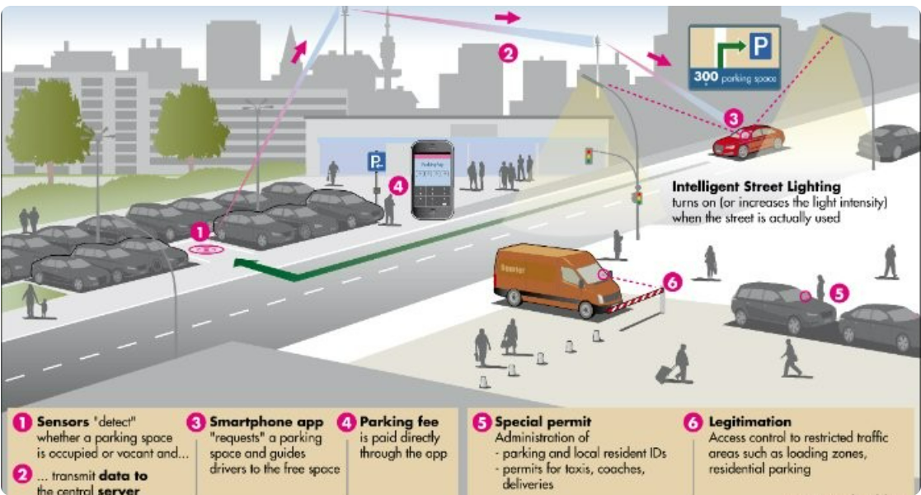
Future Scope

Slide 11
Conclusion
So our proposed project aims at easing the parking management system.
Not only managing the parking space efficiently ,it will also eradicate the problem illegal parking or unowned vehicle.
As parking is a big concerned , specially in urban areas ,this system will help to minimize parking stress

Slide 12
References
https://www.nature.com/articles/s41598-022-10076-4
https://www.mokosmart.com/smart-parking-system-using-iot/
https://learn.adafruit.com/pir-passive-infrared-proximity-motion-sensor/how-pirs-work
https://nevonprojects.com/iot-car-parking-system/
IoT based smart parking system Publisher: IEEE

